Slide 1
UNIT V
ROM

Slide 2
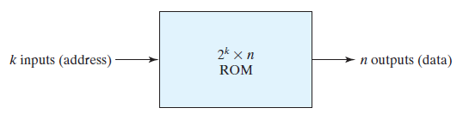
ROM
Read‐only memory (ROM)
Permanent binary information
The binary information specified by the designer
Static and Non volatile

Slide 3
Types of ROM
Programmed in different ways
Mask programming
PROM
Programmable read‐only memory
EPROM
Erasable PROM
EEPROM
Electrically erasable PROM (EEPROM or E²PROM)
Flash memory devices

Slide 4
Types of ROM
1. Mask programming
Programming is done by the semiconductor company
During the last fabrication process of the unit
Customer fill out the truth table
In a special form provided by the manufacturer
The manufacturer makes the corresponding mask for the paths to produce the 1’s and 0’s according to the customer’s truth table
Costly because the vendor charges
Economical only if a large quantity of the same configuration

Slide 5
Types of ROM
2. PROM
Programmable read‐only memory
Fuse
Initially all the fuses are intact ie: all bits are 1
Fuses are blown by the application of a high‐voltage pulse to the device through a special pin
A blown fuse defines a binary 0 state and an intact fuse gives a binary 1 state
This procedure allows the user to program
Special instruments called PROM programmers are available commercially to facilitate the procedure
Procedures for programming ROMs are hardware procedures, even though the word
programming is used
Once programmed then irreversible

Slide 6
Types of ROM
3. EPROM
Erasable PROM
Can be restructured to the initial state even though it has been programmed previously
When placed under a special ultraviolet light for a given length of time, the shortwave radiation discharges the internal floating gates that serve as the programmed connections
Can be reprogrammed to a new set of values

Slide 7
Types of ROM
4. EEPROM
Electrically erasable PROM (EEPROM or E²PROM)
Like EPROM
Except that the previously programmed connections can be erased with an electrical signal instead of ultraviolet light
The advantage is that the device can be erased without removing it from its socket

Slide 8
Types of ROM
5. Flash memory devices
Similar to EEPROMs
But have additional built‐in circuitry to selectively program and erase the device in‐circuit, without the need for a special programmer
Application in modern technology
Cell phones, digital cameras, set‐top boxes, digital TV, telecommunications, nonvolatile data storage, microcontrollers
Their low consumption of power makes them an attractive storage medium for laptop and notebook computers

Slide 9
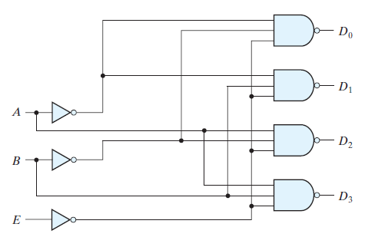
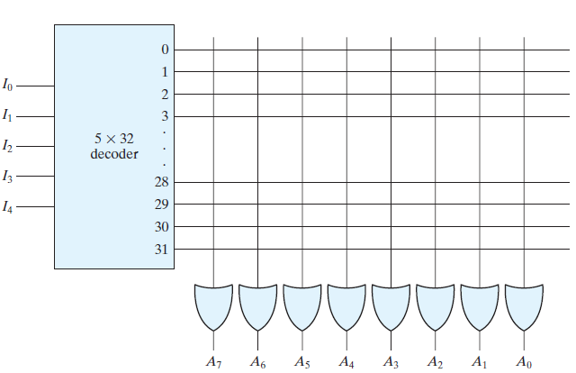
ROM
Decoder
32 * 8 ROM
32 words of 8 bit each
5 bits represent 32 different address
5*32 decoder is used
Decoder need 32 AND gates with 5 input each
Output need 8 OR gates with 32 input each
32*8 = 256 intersections
32*8 Rom

Slide 10
ROM
32*8 Rom
32*8 ROM
32 AND gates
8 OR gates
In general
2^{k}*n ROM
2^{K} AND gates
n OR gates

Slide 11
Programmable logic device (PLD)
Programmable logic device (PLD)
Electronic component used to build digital circuits
It must be programmed before using in a circuit
The binary information in a specified fashion is stored and then embedded within the hardware in a process is referred to as programming the device
Examples of PLDs:
PROM
Programmable logic array(PLA)
Programmable array logic (PAL)
Field‐programmable gate array (FPGA)

Slide 12
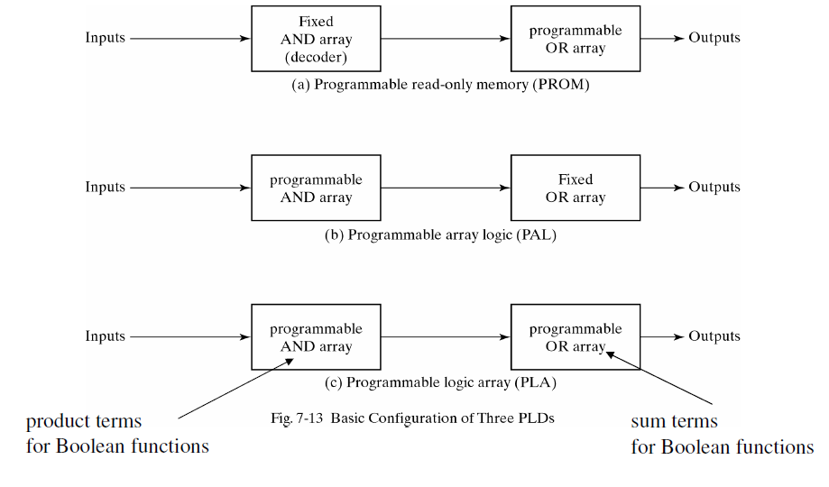
Basic configuration of three PLDs

Slide 13
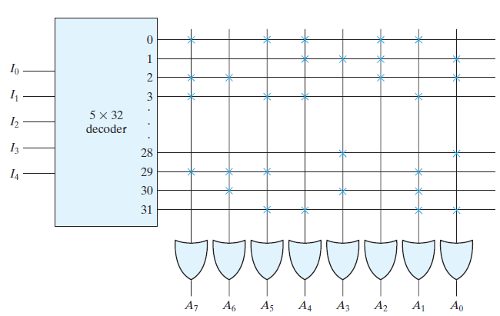
PROM
256 intersections are programmable
Intersections are equivalent to a switch
Called - crosspoint
Various physical devices are used to implement crosspoint switches
Simplest technologies – fuse
Fuse is opened or “blown” by the application of a high‐voltage pulse

Slide 14
PROM
Fuse is opened or “blown” by the application of a high‐voltage pulse
Fuse blown for ‘0’
Other wise it is ‘1’
Eg address 3
Data 10110010
Blown A6,A3,A2,A0

Slide 15
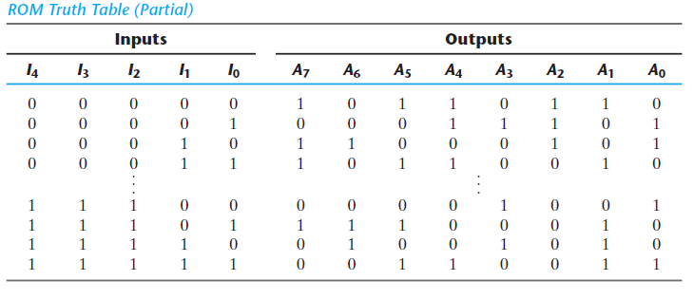

Combinational Circuit Implementation
Truth table specifies the content in each address word

Slide 16
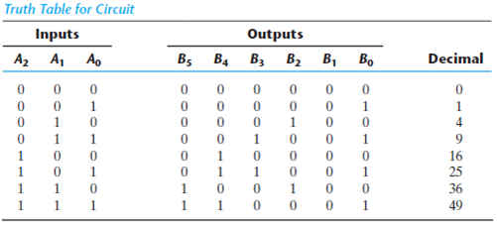
Combinational Circuit Implementation : example
Design a combinational circuit using a ROM. The circuit accepts a three‐bit number and
outputs a binary number equal to the square of the input number.

Slide 17
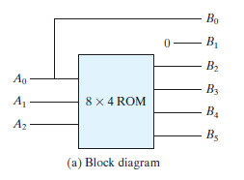
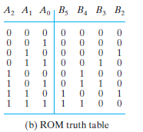
Combinational Circuit Implementation : example

Slide 18
PROGRAMMABLE LOGIC ARRAY
Similar to the PROM
Except that the PLA does not provide full decoding of the variables
Also it does not generate all the minterms
The decoder is replaced by an array of AND gates
And gates can be programmed to generate any product term of the input variables
The product terms are then connected to OR gates to provide the sum of products for the required Boolean functions

Slide 19

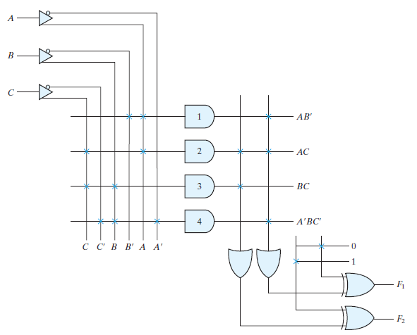
PROGRAMMABLE LOGIC ARRAY
X xor 1= X’
X xor 0 = X

Slide 20
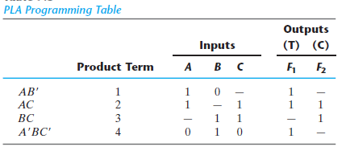
PROGRAMMABLE LOGIC ARRAY
T : True
C : Complement
1 : True
0 : Complement
- : Term is absent
Path between i/p and AND gate
Path between AND gate and OR gate

Slide 21
PROGRAMMABLE LOGIC ARRAY
X xor 1= X’
X xor 0 = X

Slide 22
PROGRAMMABLE LOGIC ARRAY
To design PLA
n input
k product term
m output
Needs
n buffer- inverter gates
k AND gates
m OR gates and XOR gates
Eg: 3 input 4 product term 2 output

Slide 23


PLA : example
Implement the following two Boolean functions with a PLA:

Slide 24
PLA : example
A/BC | 00 | 01 | 11 | 10
0 | 1 | 1 |  | 1
1 | 1
A/BC | 00 | 01 | 11 | 10
0 | 1
1 |  | 1 | 1 | 1
F1=A’B’+A’C’+B’C’
F2=A’B’C’ + AB +AC
A/BC | 00 | 01 | 11 | 10
0 |  |  | 0
1 |  | 0 | 0 | 0
A/BC | 00 | 01 | 11 | 10
0 |  | 0 | 0 | 0
1 | 0
F2’ = ABC +A’B +A’C
F1’=BC +AB +AC
F1’ and F2 has many terms in common

Slide 25
PLA : example
F1’ and F2 has many terms in common
F1’=BC +AB +AC
F2=A’B’C’ + AB +AC
 | Product Term | Input A B C | Output (T) F1 F2
AB | 1 | 1 1 - | 1
AC | 2 | 1 - 1 | 1
BC | 3 | - 1 1 | 1 -
A’B’C’ | 4 | 0 0 0 | - 1

Slide 26


PLA : example
F1’ and F2 has many terms in common
F1’=BC +AB +AC
 | Product Term | Input A B C | Output (T) F1 F2
AB | 1 | 1 1 - | 1
AC | 2 | 1 - 1 | 1
BC | 3 | - 1 1 | 1 -
A’B’C’ | 4 | 0 0 0 | - 1
F2=A’B’C’ + AB +AC
C C’ B B’ A, A’
FPGA
0
F2
0
1
F1

Slide 27
PLA : example
F1’ and F2 has many terms in common
F1’=BC +AB +AC
 | Product Term | Input A B C | Output (T) F1 F2
AB | 1 | 1 1 - | 1
AC | 2 | 1 - 1 | 1
BC | 3 | - 1 1 | 1 -
A’B’C’ | 4 | 0 0 0 | - 1
F2=A’B’C’ + AB +AC
C C’ B B’ A, A’
FPGA
0
F2
0
1
F1

Slide 28
PAL
PLD with fixed OR array and a programmable AND array
Is easier to program
But is not as flexible as, the PLA.
Figure AND–OR array that is three wide, the term used to indicate that there are three programmable AND gates in each section and one fixed OR gate

Slide 29
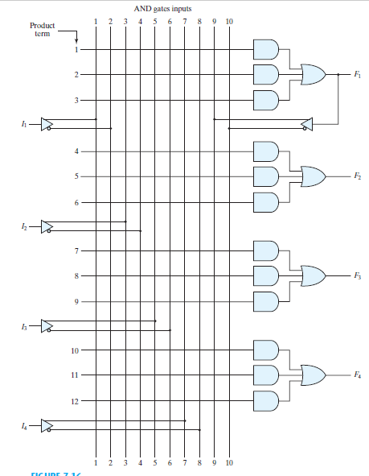
PAL

Slide 30
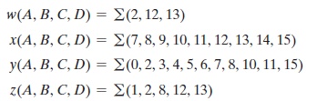
PAL : Boolean Function example

Slide 31





PAL : Boolean Function example
AB/CD | 00 | 01 | 11 | 10
00
01 |  |  | 1
11 | 1 | 1 | 1 | 1
10 | 1 | 1 | 1 | 1
AB/CD | 00 | 01 | 11 | 10
00 |  |  |  | 1
01
11 | 1 | 1
10
AB/CD | 00 | 01 | 11 | 10
00 | 1 |  | 1 | 1
01 | 1 | 1 | 1 | 1
11 |  |  | 1
10 | 1 |  | 1 | 1
AB/CD | 00 | 01 | 11 | 10
00 |  | 1 |  | 1
01
11 | 1 | 1
10 | 1

Slide 32
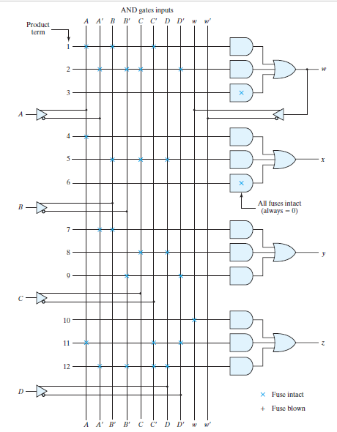
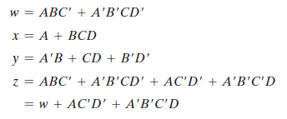
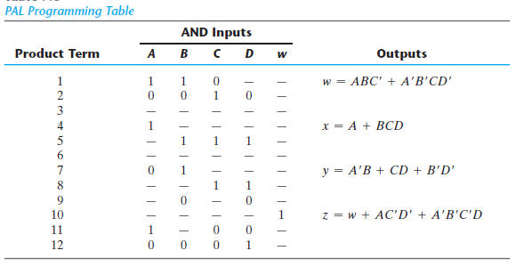
PAL : Boolean Function example

Slide 33
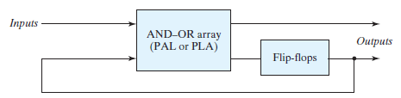
SEQUENTIAL PROGRAMMABLE DEVICES
Digital systems are designed with flip‐flops and gates.
Combinational PLD consists of only gates
It is necessary to include external flip‐flops to PLD
Sequential programmable devices include both gates and flip‐flops
It can be programmed to perform a variety of sequential‐circuit functions
Three major types
1. Sequential (or simple) programmable logic device (SPLD)
2. Complex programmable logic device (CPLD)
3. Field‐programmable gate array (FPGA)

Slide 34
SPLD
Sequential (Simple) PLD
IC includes
Flip‐flops
AND–OR array
A PAL or PLA include flip‐flops to form a register
Outputs can be taken from the OR gates or from flip‐flops
D or JK Flip flop is used

Slide 35
SPLD
PLA
Field‐programmable logic sequencer (FPLS)
The first programmable device to support sequential circuit implementation
FPLS is organized around a PLA with several outputs driving flip‐flops
The flip‐flops are flexible - programmed to operate as either the JK or the D
Disadvantage
Did not succeed commercially
Due to too many programmable connections
PAL
A PAL that includes flip‐flops is referred to as a registered PAL
To signify that the device contains flip‐flops in addition to the AND–OR array

Slide 36
SPLD
SPLD is called a macrocell
Circuit that contains a SOP combinational logic function and an optional flip‐flop
AND–OR sum‐of‐products function or it can be any one of the two‐level implementations
Typical SPLD has from 8 to 10 macrocells within one IC package

Slide 37
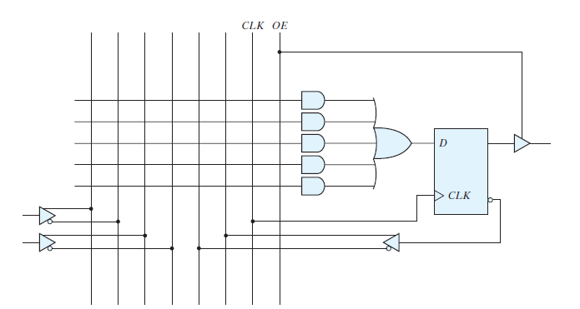
SPLD
Basic macrocell logic

Slide 38
CPLD
The design of a digital system often requires the connection of several PLD devices to produce the complete specification
It is more economical to use a CPLD
It is a collection of individual PLDs on a single integrated circuit
A programmable interconnection structure allows the PLDs to be connected to each other

Slide 39
CPLD
The device consists of multiple PLDs interconnected through a programmable switch matrix
The input–output (I/O) blocks provide the connections to the IC pins
Each I/O pin is driven by a three state buffer and can be programmed to act as input or output
The switch matrix receives inputs from the I/O block and directs them to the individual macrocells
Selected outputs from macrocells are sent to the outputs as needed
Each PLD typically contains from 8 to 16 macrocells
If a macrocell has unused product terms, they can be used by other nearby macrocells.
Macrocell flip‐flop is programmed to act as a D, JK, or T flip‐flop

Slide 40
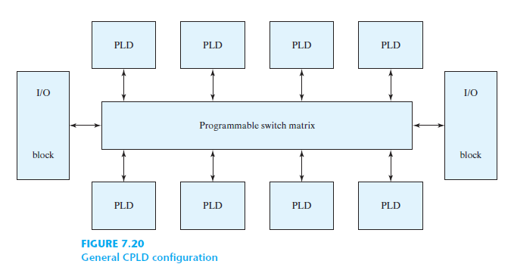
CPLD

Slide 41
FPGA
A field‐programmable gate array (FPGA) is a VLSI circuit that can be programmed at the user’s location
It is an array of millions of logic blocks surrounded by programmable input and output blocks and connected together via programmable interconnections
There is a wide variety of internal configurations
The performance of each type of device depends on the circuit contained in its logic blocks and the efficiency of its programmed interconnections
A typical FPGA logic block consists of lookup tables, multiplexers, gates, and flip‐flops

Slide 42
FPGA
A lookup table is a truth table stored in an SRAM and provides the combinational circuit functions for the logic block
The combinational logic section, along with a number of programmable multiplexers, is used to configure the input equations for the flip‐flop and the output of the logic Block
The advantage of using RAM instead of ROM to store the truth table is that the table can be programmed by writing into memory
The disadvantage is that the memory is volatile and presents the need for the lookup table’s content to be reloaded in the event that power is disrupted
The program can be downloaded either from a host computer or from an onboard PROM.
The program remains in SRAM until the FPGA is reprogrammed or the power is turned off
The device must be reprogrammed every time power is turned on
The ability to reprogram the FPGA can serve a variety of applications by using different logic implementations in the program

